Slide 1
Robot GUI
Brittany Henthorn & roger patino

Slide 2
About
Teach students math to increase academic performance and interest in mathematics
The user-interface allows the students to control the robot in an easy, straightforward way

Slide 3
Front End Design
Created using python
Tkinter widgets
Simple, user-friendly for students

Slide 4
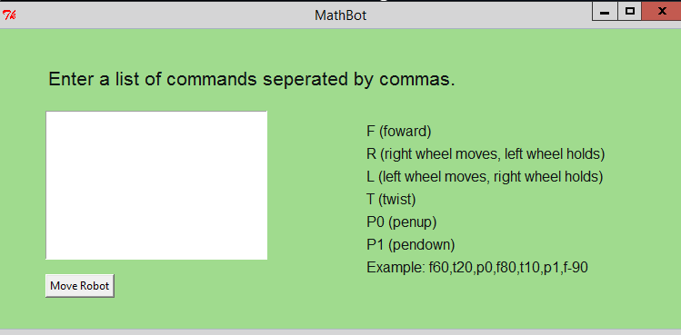
Front End Design

Slide 5
Front End Design
Commands are entered into a text box
The list of commands, and an example input, are displayed on the GUI so students can get started right away

Slide 6
Commands
F (Move forward)
R (right wheel moves)
L (left wheel moves)
T (Twist)
P0 (Pen down)
P1 (Pen up)
P1
F20
T10

Slide 7
Example
F60,T20,p0,f80,t10,P1,F-90

Slide 8
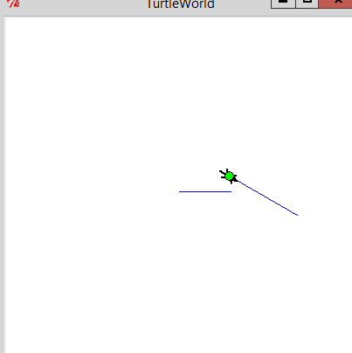
Functionality
Turtle world
example
Each command is coded with the help of swampy turtle world to simulate actual robot movement.

Slide 9
Functionality
parse function
def Parse():
inputs=stringtext.get("1.0",END)
inputs+=","
strbeg=0;
for i in range (0,len(inputs)):
if inputs[i]==",":
Move(inputs[strbeg:i])
strbeg=i+1
Takes user input
Finds comma location
Sends command to Move()
Move() determines the command and sends to the robot

Slide 10
Functionality
Move function
#left wheel moves, right wheel holds
print "placeholder"
elif command[0]=="T":
#twist
rt(bob, (int(command[1:])))
elif command[0]=="P":
#pendown, penup
if int(command[1])==1:
bob.pd()
elif int(command[1])==0:
bob.pu()
def Move(command):
command=command.upper()
if command[0]=="F":
#forward
fd(bob,(int(command[1:]))
elif command[0]=="R":
#right wheel moves, left wheel holds
print "placeholder“
elif command[0]=="L":

Slide 11
Functionality
Turtle World does not allow for commands R and L
Individual wheel movements will have to be programmed between the raspberry pi and the arduino

